Slide 1
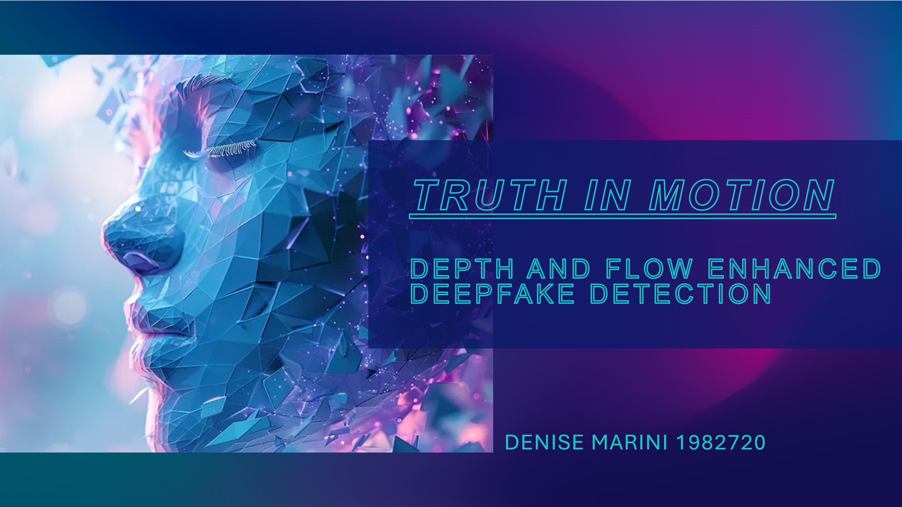

Slide 2
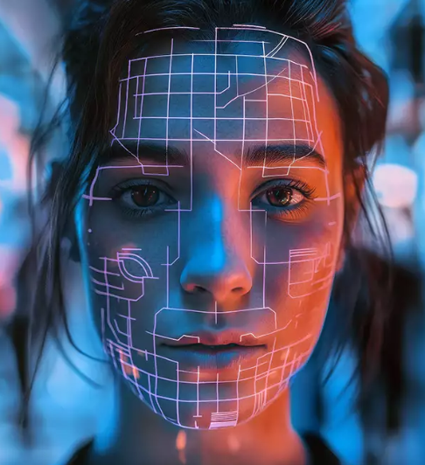
What is a Deepfake?
A deepfake is a type of media (video, audio, or image) altered using artificial intelligence to make it appear that someone said or did something they never actually did.
It uses neural networks, especially GANs, to realistically replace faces or voices.
Deepfakes can be used for satire, art, or, unfortunately, for manipulation and disinformation.

Slide 3

Deepfake detection: state of art
Deepfake Video Detection through Optical Flow based CNN
optical flow fields
CNN to highlight inter-frame motion inconsistencies
FaceForensics++: Learning to Detect Manipulated Facial Images
large-scale benchmark
deep learning detectors
>99% accuracy on raw and >95% on compressed data
Improved Optical Flow Estimation Method for Deepfake Videos
optical flow estimation
CNN classifiers
~82% accuracyFaceForensics++: Learning to Detect Manipulated Facial Images

Slide 4
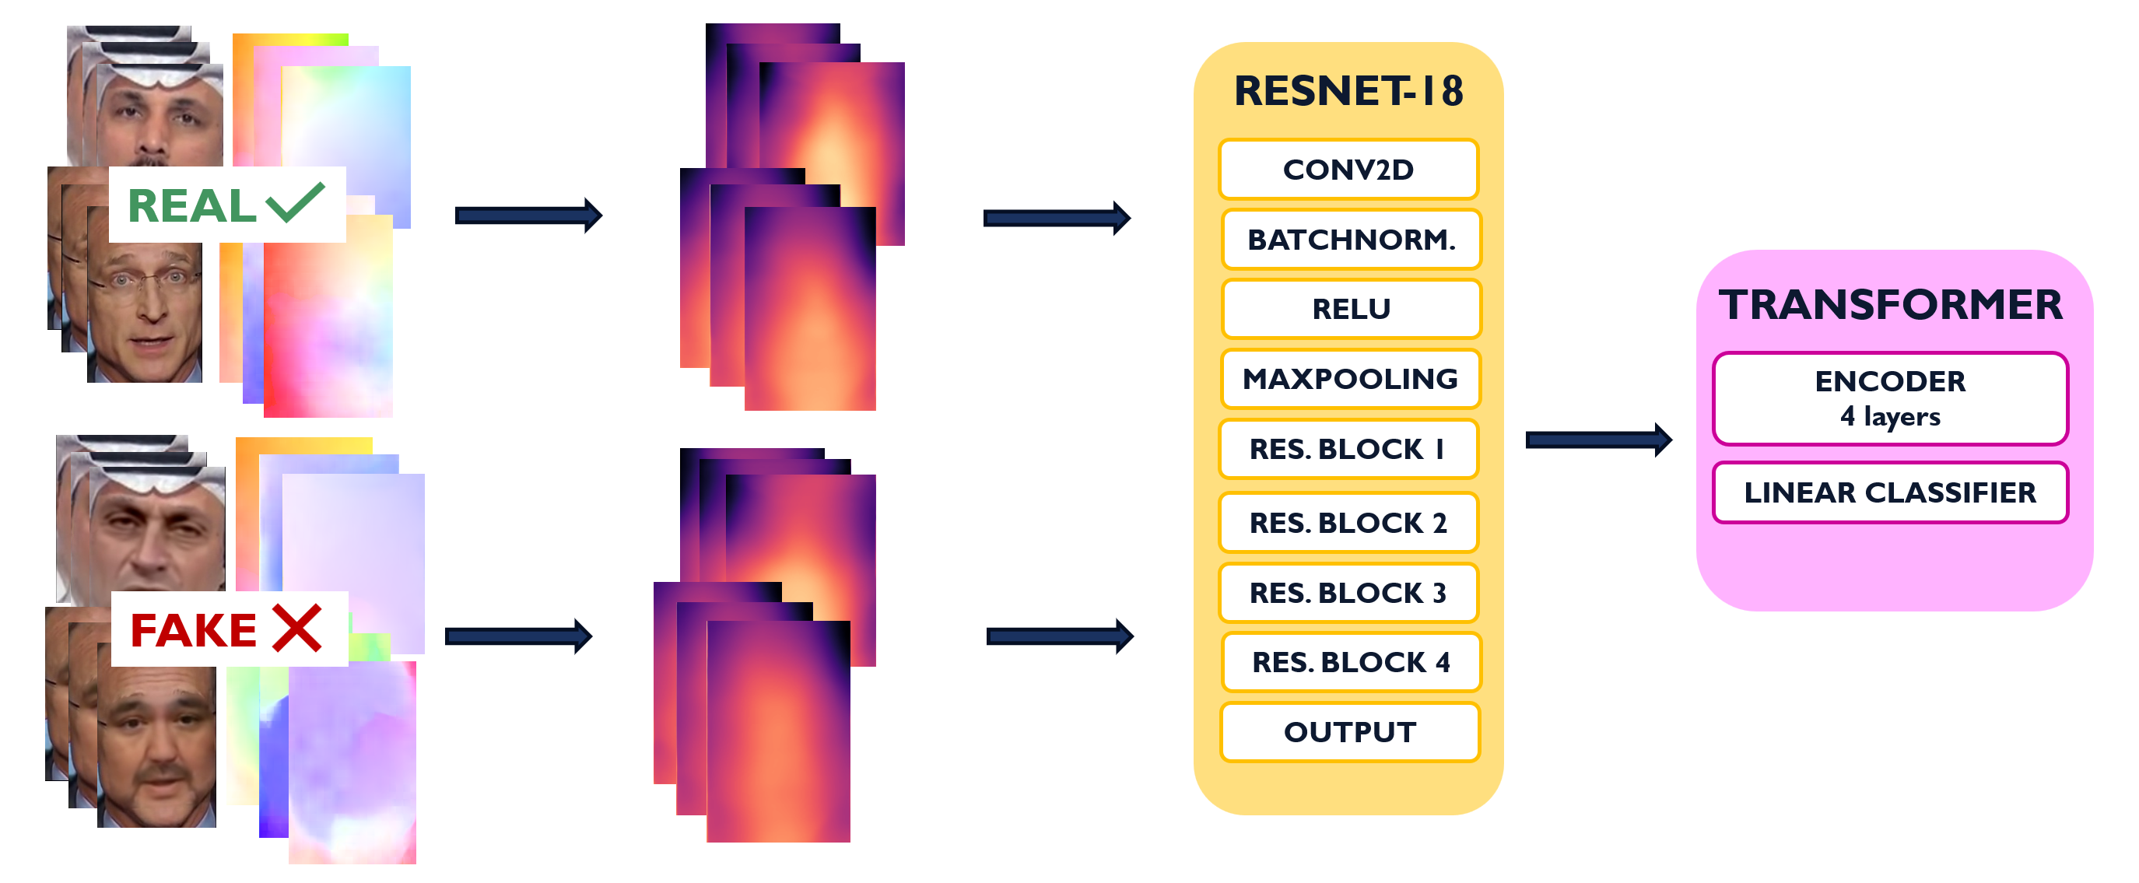
Enhanced deepfake detection

Slide 5
dataset
The dataset used in this work is taken from FaceForensics++, using the raw videos. For manipulated samples, the following manipulation categories were selected: DeepFakes, Face2Face and FaceSwap
Real
DeepFakes
Face2Face
FaceSwap
To build a balanced training dataset, the following videos were selected: 500 real videos and 166 manipulated videos per category. For the test set: approximately 100 real videos and 33 manipulated videos per category

Slide 6

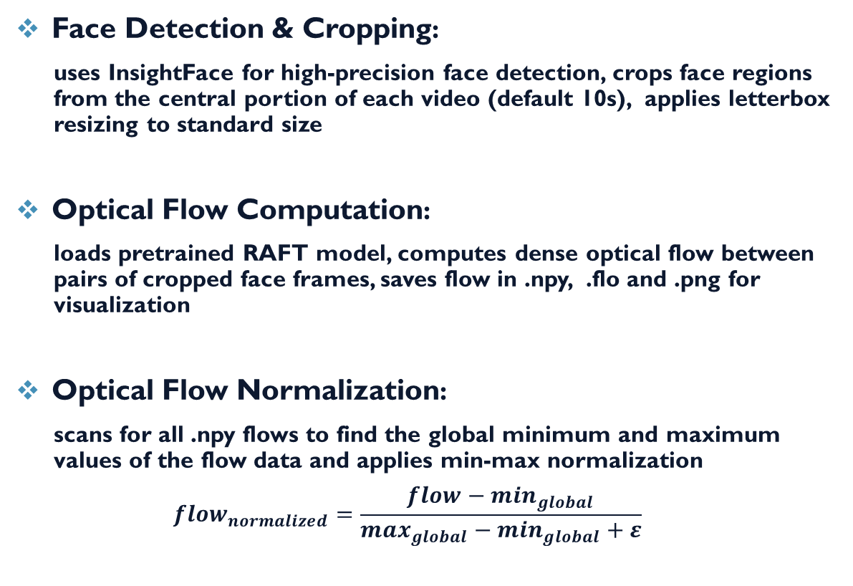
Frame extraction + optical flow
Face Detection & Cropping:
uses InsightFace for high-precision face detection, crops face regions from the central portion of each video (default 10s), applies letterbox resizing to standard size
Optical Flow Computation:
loads pretrained RAFT model, computes dense optical flow between pairs of cropped face frames, saves flow in .npy, .flo and .png for visualization
Optical Flow Normalization:
scans for all .npy flows to find the global minimum and maximum values of the flow data and applies min-max normalization
$${flow}_{normalized}=\frac{flow−\min_{global}}{\max_{global}−\min_{global}+ε}$$

Slide 7
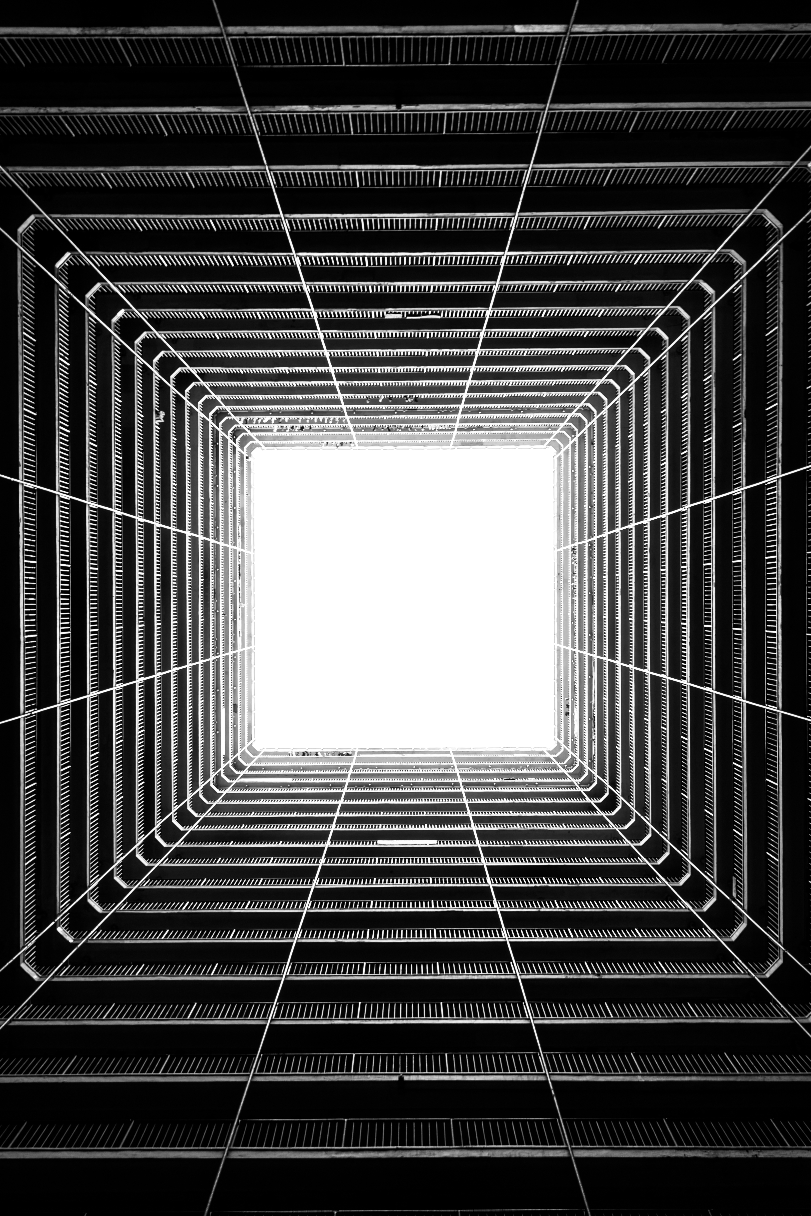
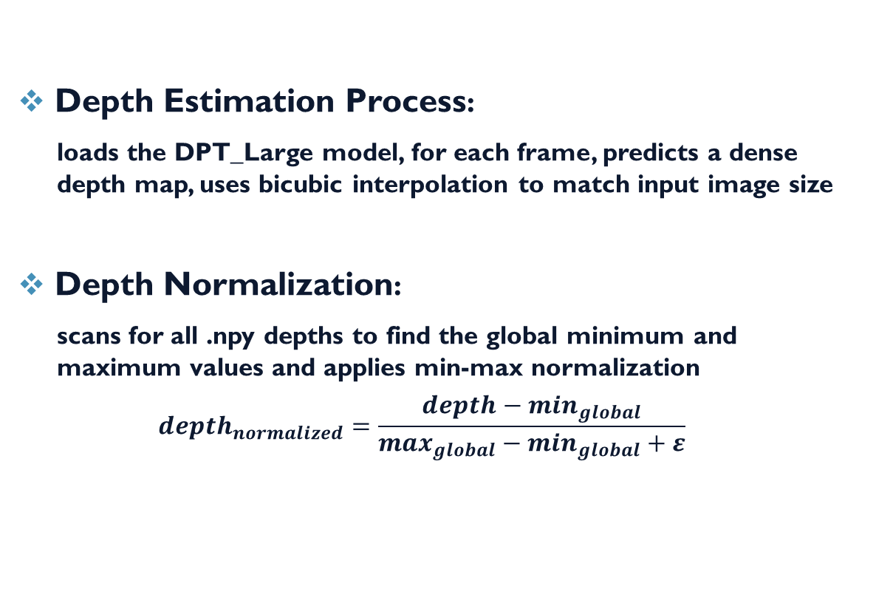
Depth estimation
Depth Estimation Process:
loads the DPT_Large model, for each frame, predicts a dense depth map, uses bicubic interpolation to match input image size
Depth Normalization:
scans for all .npy depths to find the global minimum and maximum values and applies min-max normalization
$${depth}_{normalized}=\frac{depth−\min_{global}}{\max_{global}−\min_{global}+ε}$$

Slide 8

Resnet-18 + transformer
Dataset & Preprocessing: a custom class loads 7 frames per sample and corresponding depths and optical flows
CNN Backbone – Modified ResNet18:
accepts 6-channel input: RGB (3) + Flow (2) + Depth (1)
outputs 512-dimensional feature vectors which encodes aspect, moving and depth
Transformer Head:
capture long-range dependencies across frames
analyzes how frames evolve trought time
consists of 4 layers, 8 heads, outputs a binary prediction

Slide 9

Resnet-18 + transformer: why combine them?
The CNN specializes in local spatial analysis detecting within each frame:
visual artifacts
textures
fine details
The Transformer excels at global temporal modeling understanding:
motion consistency
cross-frame anomalies
Together, they allow the model to capture both the visual quality and temporal consistency of a video, leading to a more reliable and robust deepfake detection system.

Slide 10
Pruning and quantization
Goal: reduce the size and computational cost of a pretrained DeepfakeDetector model
Pruning:
applies 30% unstructured L1 pruning to all convolutional al linear layers
removes less important weights
Fine-tuning after pruning:
uses 50% of the original dataset to re-train the pruned model for 3 epochs
stabilizes the model after pruning and recovers potential accuracy loss
Quantization:
applies quantization-aware transformation to the final linear layer (classifier head)
converts model weights to 8-bit integers
Testing:
loads the quantized model and runs inference on 10 random samples
prints predicted vs. true labels to verify correctness post-compression

Slide 11




Experiments and problems
Use of compressed videos
Use flows and depth not normalized
Use of Timesformer
Use of Vit Transformer
Use of transformer without the CNN as feature extractor
Different type of algorithms for optical flow and depth
Use of MTCNN and then RetinaFace for frames extraction
The main problems were due to a large amount of time during training, the data that weren’t normalized, the absence of a CNN as feature extractor and the combination of all of them

Slide 12
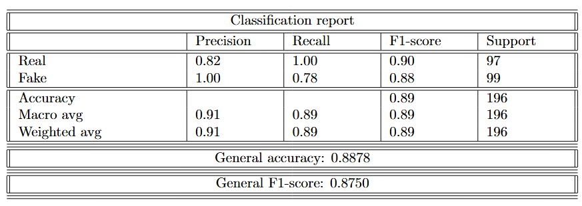
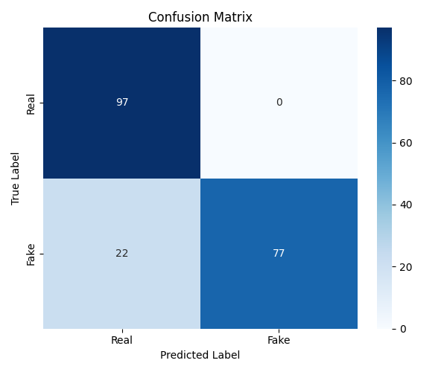
Results obtained
The results shown here refer to the test phase performed on a balanced dataset composed of both original and manipulated videos
The model is perfect at recognizing real videos, while 22 fake videos were misclassified
Overall, the performance is very strong, with a total accuracy of 88.78% and a high general F1-score

Slide 13

CONCLUSIONS and future work
The model presented is good in real/fake discrimination
The main errors involve fake videos that were not detected (22 out of 99), indicating room for improvement
Explore the use of techniques to improve performance on unseen manipulation methods
Integrate audio, metadata, and compression artifacts for more comprehensive detection

Slide 14

THANKS FOR THE ATTENTION

